Slide 1
cts
Seamless AV
QUARTERLY BUSINESS REVIEW
Q1 FY2027
Results, departments, spending, customers, cash and utilisation
Finance Operations Manager
Notes:
Monthly Business Review for September 2026. Every figure in this pack is drawn from the Financial Controller Pack, which reconciles to the Xero general ledger to the cent for each department and for the company.
Revenue for the month was $562k against a budget of $414k, exceeding budget by $148k. EBITDA was a loss of $32k against a budgeted loss of $107k.
The month is explained by gross margin and the fixed overhead base rather than by sales performance.

Slide 2

AGENDA
Scope Of This Review
01
Financial performance
Profit and loss summary, revenue against budget, and the three year comparisons
02
Departmental performance
Every department's result for Q1 FY2027 and how it was made
03
Operating expenditure
Where the money goes: cost distribution, operating expense, labour and employment
04
Customers and receivables
Top ten customers, receivables and days sales outstanding
05
People and utilisation
Chargeable hours by department and the profit they produce
06
Budget and outlook
Revenue by month against budget, and what we do about it
Notes:
The review is set out in five sections.
Financial performance opens, as it carries the result for the month. What we spend follows, because the cost base explains most of the outcome. Customers and cash, people and utilisation, and the budget outlook complete the review.

Slide 3
EXECUTIVE SUMMARY|Performance Summary, First Quarter FY2027
SUPPORT
EVENTS
VIDEO
INTEGRATION
CONSULTING
TOTAL
$715k
$421k
$40k
$441k
$7k
$1,624k
revenue
revenue
revenue
revenue
revenue
revenue
43% gross margin
58% gross margin
76% gross margin
12% gross margin
-42% gross margin
39% gross margin
+$67k after overhead
$(40)k after overhead
$(12)k after overhead
+$25k after overhead
$(49)k after overhead
$(9)k after overhead
Behind budget by $28k
Ahead of budget by $99k
Behind budget by $45k
Behind budget by $266k
Behind budget by $131k
Behind budget by $372k
Revenue
Gross margin
Overheads
EBITDA
Break even needs
$1,624k
38.9%
$641k
$6k
$1,648k
budget $1,996k
budget 45.7%
budget $690k
budget $223k
running at $1,624k
COMMENTARY
The quarter in summary. Revenue was $1,624k against a budget of $1,996k, short by $372k or 19%. Almost all of the shortfall is Integration at $266k and Consulting at $131k. Two budgeted jobs explain much of that gap. PwC was budgeted at $336k in August and will not now happen, and Bankwest was budgeted at $49k in September and has moved into Q2. Support is the only department covering its allocated overhead, at $67k, while Events lost $40k and Consulting $49k.
Notes:
The quarter in summary. Revenue was $1,624k against a budget of $1,996k, short by $372k or 19%. Almost all of the shortfall is Integration at $266k and Consulting at $131k. Two budgeted jobs explain much of that gap. PwC was budgeted at $336k in August and will not now happen, and Bankwest was budgeted at $49k in September and has moved into Q2. Support is the only department covering its allocated overhead, at $67k, while Events lost $40k and Consulting $49k.

Slide 4
SECTION
01
Financial performance
The P&L for Q1 FY2027 and the year to date
Notes:
Financial performance for September 2026 and the quarter to date.

Slide 5
FINANCIAL PERFORMANCE|Summary For The First Quarter FY2027
COMMENTARY
Revenue was $1,624k against $1,996k budgeted, $372k or 19% short.
PwC was budgeted at $336k in August and will not now happen.
Bankwest was budgeted at $49k in September and has moved into Q2.
Cost of sales came in $92k under budget, not enough to hold the margin.
Gross margin was 38.9% against 45.7% budgeted.
Overheads were $641k, $48k under budget.
EBITDA was $6k against $223k budgeted.
The quarter ends at a net loss of $6k.
August was the only month in profit, at $60k. July lost $24k and September lost $41k.
Notes:
Revenue was $1,624k against $1,996k budgeted, $372k or 19% short.
PwC was budgeted at $336k in August and will not now happen.
Bankwest was budgeted at $49k in September and has moved into Q2.
Cost of sales came in $92k under budget, not enough to hold the margin.
Gross margin was 38.9% against 45.7% budgeted.
Overheads were $641k, $48k under budget.
EBITDA was $6k against $223k budgeted.
The quarter ends at a net loss of $6k.
August was the only month in profit, at $60k. July lost $24k and September lost $41k.

Slide 6
FINANCIAL PERFORMANCE|Profit And Loss Summary, Income
COMMENTARY
At the year-to-date gross margin of 38.9%, monthly revenue of approximately $549k is needed to cover overheads. The current average is $541k.
September revenue was $148k above budget, but EBITDA remained a loss of $32k.
Gross margin was 33.4%, compared with the 30.1% budget and 45.5% in September last year.
Overheads were $230k, slightly below the $232k budget.
Year-to-date EBITDA is $6k against a $223k budget. Our forecast should place greater focus on gross margin and profitability.
Notes:
The P&L summary is taken from the Summary tab of the Financial Controller Pack and is shown as it appears on screen with the outline closed.
Revenue of $562k against a budget of $414k, exceeding budget by $148k and 58% above the $356k recorded in September last year.
Gross profit of $188k at 33.4%, against a budgeted 30.1% and 45.5% in September last year. The budgeted margin for September was unusually low, so exceeding it reflects the budget rather than an improvement in delivery.
Overheads of $230k against a budget of $232k.
EBITDA a loss of $32k against a budgeted loss of $107k, and a net loss of $41k after depreciation and amortisation of $10k.
Year to date, revenue of $1,624k against $1,996k, behind budget by $372k, with EBITDA of $6k against $223k.
The figure worth carrying from this slide is break even. At the year to date gross margin of 38.9%, the business requires $549k of revenue each month to cover overheads and is averaging $541k. That gap is structural, and additional sales at the current margin would not close it.

Slide 7
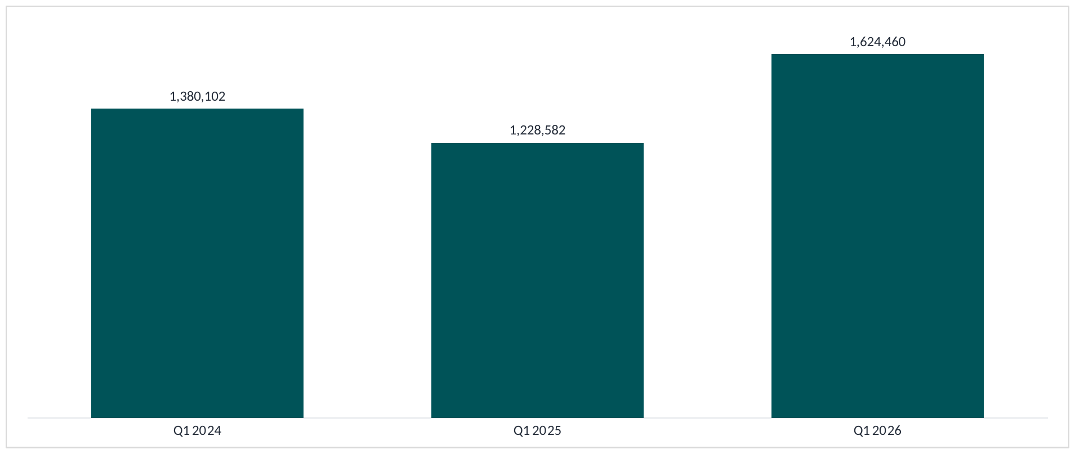


FINANCIAL PERFORMANCE|Quarterly Revenue, Three Year Comparison
COMMENTARY
The first quarter billed $1,624k, the strongest of the three years.
The same quarter last year billed $1,229k, and two years ago $1,380k.
This quarter is 32% ahead of last year and 18% ahead of the year before that.
It is still $372k short of the $1,996k budgeted for it.
Notes:
Revenue by quarter across three years, taken from the Xero History tab.
First quarter: FY25 $1,380k, FY26 $1,229k, FY27 $1,624k.
Second quarter: FY25 $2,277k, FY26 $1,895k.
Third quarter: FY25 $1,873k, FY26 $1,304k.
Fourth quarter: FY25 $1,470k, FY26 $1,686k.
Three things come out of this that the single quarter comparison could not show.
The first is that the quarter just closed is the smallest quarter of the year in both completed years, and FY27 has made it the largest first quarter of the three. That is a genuinely good result and it is worth saying so.
The second is where FY26 actually lost its year. It was the third quarter, January to March, which fell $570k or 30.4% below the same quarter of FY25. The first quarter of FY26 was 11.0% below and the second 16.8% below, but the third is where the damage was done. The fourth quarter was the one quarter FY26 beat FY25, by $216k or 14.7%.
The third is what is immediately ahead. The second quarter has carried 32.5% of FY25 and 31.0% of FY26, which makes it the quarter the year is won or lost in. October alone was the largest month of both completed years. The FY27 budget has October at $950k, and the first quarter has run 18.6% behind budget on revenue. A second quarter that behaves like FY26's rather than FY25's would widen the full year gap by around $380k on its own.
FY27 shows one quarter because one quarter has closed. The chart fills in as each quarter closes.

Slide 8
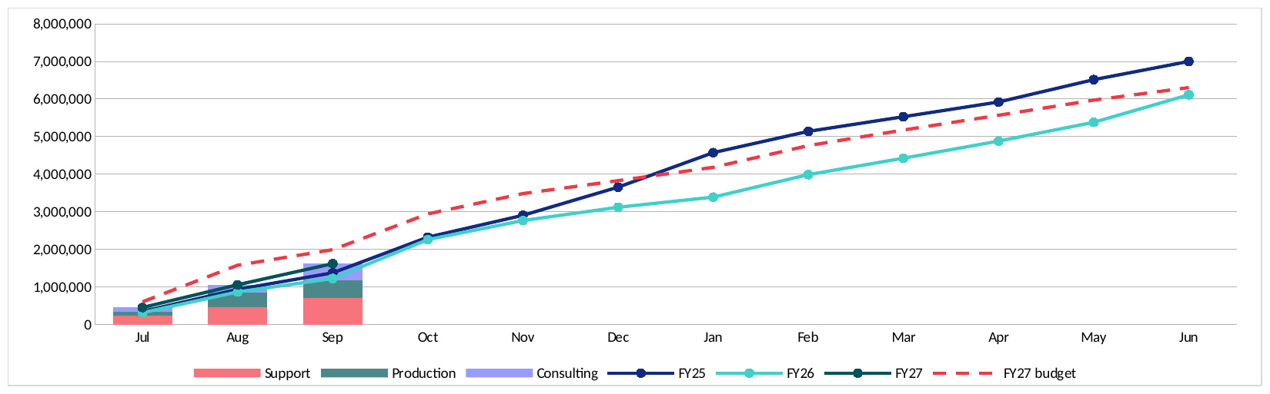
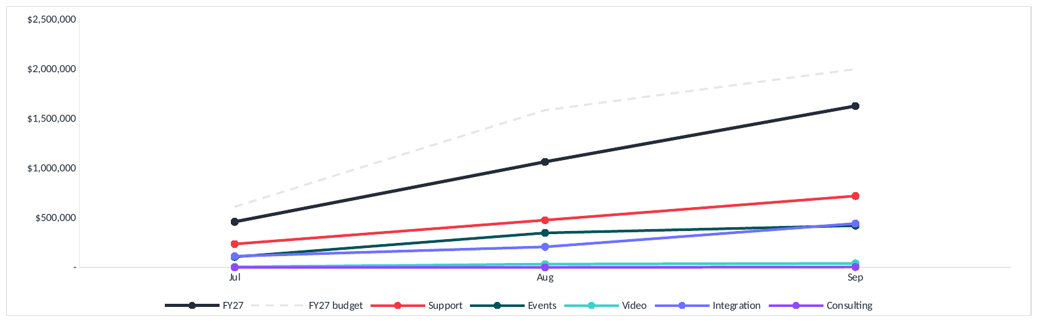
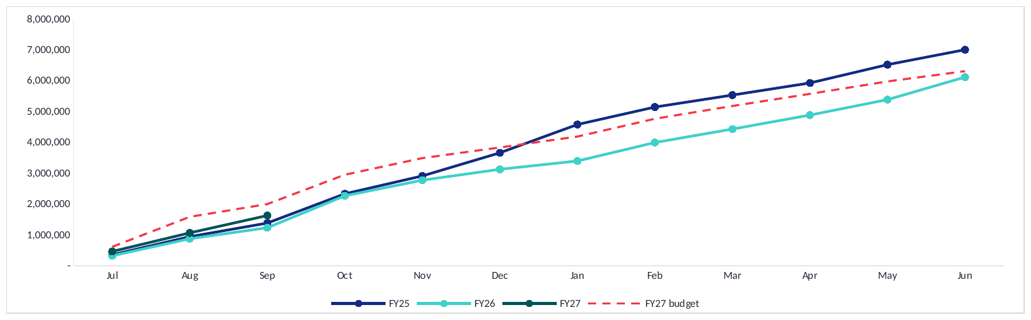
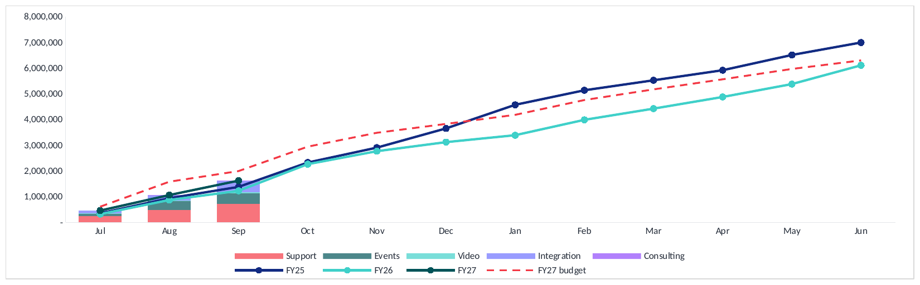
FINANCIAL PERFORMANCE|Year To Date Revenue Against Budget
COMMENTARY
The columns are revenue by reporting group. They stack to the FY27 line.
Support $715k, Production $461k, Consulting $448k.
Year to date revenue is $1,624k against a budget of $1,996k, $372k or 19% behind.
PwC was budgeted at $336k in August. That work will not now happen.
Bankwest was budgeted at $49k in September and has moved into Q2.
Revenue is still ahead of both completed years, $1,380k in FY25 and $1,229k in FY26.
Notes:
Revenue year to date on a cumulative basis, three years against the FY27 budget, taken from the Xero History tab.
At September: FY27 $1,624k, FY26 $1,229k, FY25 $1,380k, and the FY27 budget $1,996k.
The year is ahead of both completed years at this point. It is $372k or 18.6% behind the budget set for it.
Where that gap came from, month by month. July was $150k behind budget. August was $370k behind, which is where almost all of it opened. September was $148k ahead of budget, which closed part of it back. August was budgeted at $973k, the second largest month of the FY27 budget, and billed $603k.
What the two completed lines show is where a year gets lost. FY25 and FY26 track each other almost exactly from July to November. They separate in December and January. December was $396k behind and January $650k behind, $1,045k across the two months, against a full year gap of $887k. Every other month of FY26 combined was ahead of FY25.
That matters now because FY27 is about to enter the same two months, and the budget has December at $345k and January at $354k, both well below what FY25 billed in them.
The last point is the budget itself. The full year FY27 budget is $6,305k. FY25 actually billed $7,000k. The plan for this year is $696k or 9.9% below what the business delivered two years ago, and $191k or 3.1% above FY26. Being 18.6% behind that budget is the gap against a plan that was already set below the FY25 result.
The FY27 line stops at September because the months beyond it hold budget rather than actuals. The budget line runs the full year because a budget is set for the whole year.

Slide 9
FINANCIAL PERFORMANCE|Profit And Loss Summary, Cost And Profit
COMMENTARY
Year-to-date EBITDA is $6k against a budget of $223k, a shortfall of approximately $217k.
The first quarter accounted for 56% of the full-year EBITDA budget, making the current shortfall significant.
To achieve the $397k annual target, the remaining nine months would need to deliver approximately $391k, compared with the original $175k budget.
That requirement is around 1.7 times the EBITDA achieved in the whole of last financial year, making the annual target highly unlikely without a significant change in performance.
Revenue reached 81% of the year-to-date budget, while gross profit reached only 69%. Improving gross margin is a priority.
Notes:
EBITDA against budget, which is the principal risk in this pack.
The quarter produced $6k of EBITDA against a budget of $223k, a shortfall of $217k or 97.4%.
The shortfall matters more than the figure alone suggests. The FY27 budget provides for $397k of EBITDA for the year and placed $223k of that, 56%, in the first quarter. The year was planned to be earned early, and it was not, so the remaining nine months would have to carry the full amount.
To reach $397k, the nine months from October would need to produce $391k, or $43k a month. The budget asked those nine months for $175k, or $19k a month. That is 2.2 times the monthly profit the plan assumed, in the months the plan treated as the quieter ones.
For context, the whole of FY26 delivered $235k of EBITDA. The next nine months would need $391k, which is 1.7 times a full year of last year's result. In my view the full year EBITDA budget is no longer recoverable, and I would suggest the board is advised of that now rather than at the half year.
The cause is margin rather than sales. Revenue for the quarter reached 81.4% of budget, which is a reasonable result in itself. Gross profit reached 69.3% of budget. The gap between those two percentages is the issue: the business sold reasonably well and retained very little of it. September illustrates the point, with revenue exceeding budget by $148k while the month still recorded an EBITDA loss of $32k.
The cost base cannot absorb that. Overheads ran at $642k for the quarter, $214k a month, and came in $48k under budget. Spending is not the cause and there is little further to remove that would be material. Wages and premises make up most of it and both are committed for the year, so a reduction in retained margin passes straight to the result.
On break even, at the 38.9% gross margin delivered, the business requires $549k of revenue a month to cover overheads and is running at $541k. The business is trading at break even rather than at a profit, in the quarter the budget expected to be the strongest.
Two factors make the next two quarters harder. December is budgeted at a loss because the business closes for two weeks, so the second quarter cannot recover the gap. And with EBITDA at break even there is no earnings buffer, while $304k of cash sits in receivables above the 30 day target.
There is a genuine positive. The first quarter of last year was a loss of $85k, so this quarter is $91k better. The business is improving year on year. It is the budget that was set above what the business can deliver, and that distinction is worth drawing clearly.
My recommendations are to reforecast now on margin rather than revenue, to rebuild Consulting around the capacity that exists, to reset the gross margin assumption to the rate delivered over two years, to hold December as budgeted, and to provide the board with a revised full year EBITDA they can rely on.

Slide 10
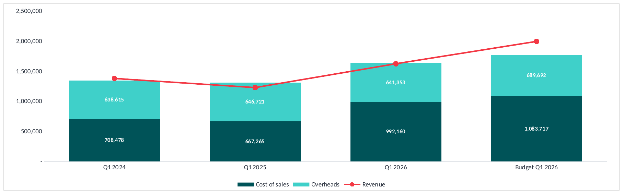


FINANCIAL PERFORMANCE|Expenditure Against Budget
COMMENTARY
Quarter spend was $1,634k against a budget of $1,773k, $140k under.
Overheads have barely moved in three years: $639k, $647k and $642k.
All the movement is cost of sales, up $325k on last year to $992k.
Revenue sat above spend in Q1 2024 and below it in both years since.
Notes:
Spend for the first quarter across three years and against budget, taken from the Xero History tab.
Q1 2026 $1,634k. Budget $1,773k. Q1 2025 $1,314k. Q1 2024 $1,347k.
The quarter is $140k or 7.9% under budget on spend. That is the opposite of the month, where spend ran over.
The split is the point. Overheads have been $639k, $647k and $642k across the three first quarters, a range of $8k on about $640k. The overhead base has not moved in three years. Every bit of the movement in spend is cost of sales, which went $708k, $667k and $992k, up $325k or 48.7% on last year.
Cost of sales rising with revenue is what should happen. Revenue rose $396k over the same year, so cost of sales rose $325k to earn it, which is a contribution of about $71k on the extra revenue. That is a thin return on the extra work and it is why the quarter is still a loss.
The red line is revenue. In Q1 2024 it sat above the spend bar and the quarter made money. In Q1 2025 and Q1 2026 it sat below and both lost money. The budget line has revenue well clear of spend, which is how it was built to make $223k.
FY25 comes from Xero, pulled 22 October 2026. The quarter is July to September, so it is fixed rather than following Setup.

Slide 11
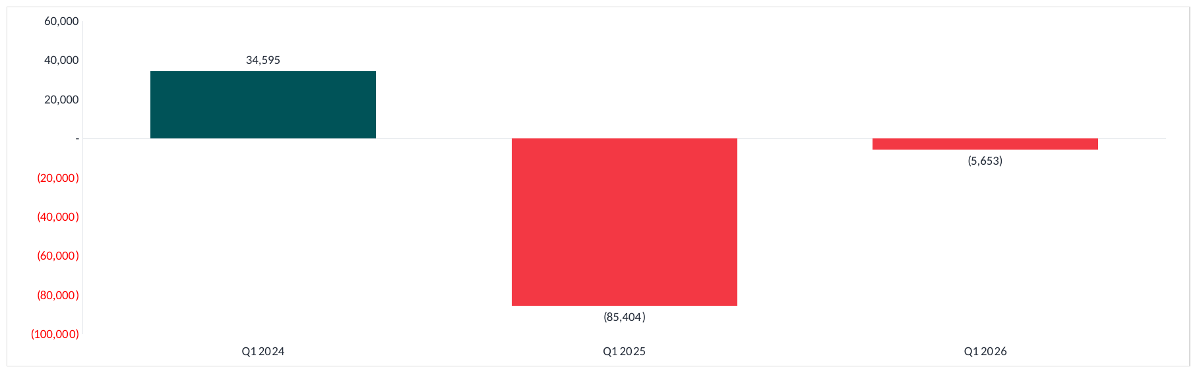


FINANCIAL PERFORMANCE|Quarterly Net Result, Three Year Comparison
COMMENTARY
The quarter lost $6k, against a $85k loss last year and a $35k profit the year before.
That is $80k better than last year and within $6k of breaking even.
It is still $229k below the budget, which had the quarter at a $223k profit.
Quarter revenue was the highest of the three at $1,624k, so again the gap is margin.
Notes:
Net profit and net loss for the first quarter across three years, taken from the Xero History tab. Net profit is the pack's own figure and includes other income.
Q1 2026 a loss of $6k. Q1 2025 a loss of $85k. Q1 2024 a profit of $35k.
The quarter has improved $80k on last year and is within $6k of breaking even. On that reading the recovery is real and the direction is right.
Against the plan it reads differently. The budget had the first quarter at a $223k profit. Coming in at a $6k loss is $229k below it.
As with the month, this is not a revenue failure. The quarter billed $1,624k, which is the highest first quarter of the three, ahead of $1,229k last year and $1,380k the year before. It earned more than either comparison and still finished below the line.
The cost of earning it is where the quarter went. Cost of sales was $992k against $708k in Q1 2024, which is $284k more on revenue $244k higher. Overheads were almost unchanged at $642k against $639k. The overhead base is not the problem and has not been for three years. The margin on the work is.
FY25 was pulled from Xero on 22 October 2026. The quarter is July to September, so it is fixed rather than following Setup.

Slide 12
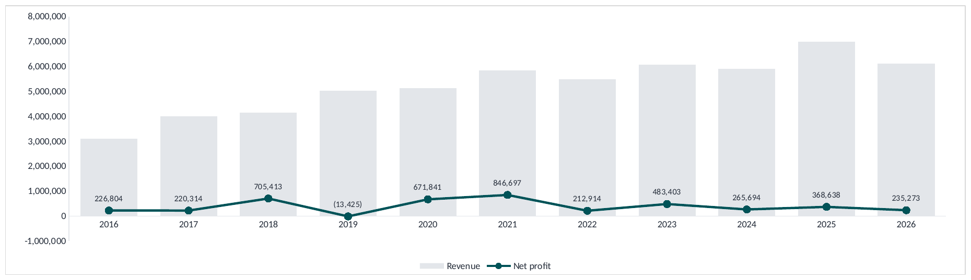


FINANCIAL PERFORMANCE| Revenue And Net Profit, Full Year
COMMENTARY
FY2026 revenue was $6,113k, down $887k on FY2025.
FY2026 net profit was $235k, against $369k the year before.
Net margin has run between 3.8% and 5.3% in four of the last five years.
2023 is the exception at 8.0%. The two strong years are 2018 at 17.0% and 2021 at 14.5%.
Revenue has roughly doubled since 2016 while profit has not.
Notes:
Full year revenue and net profit, 2016 to 2026, carried over from page 8 of the Q4 FY2026 Business Advisory pack.
This is the full year half of a pair. The page after it is the same cut on a fourth quarter.
Revenue: 3,099,680; 4,011,690; 4,142,343; 5,034,111; 5,135,991; 5,846,072; 5,484,838; 6,066,066; 5,904,585; 7,000,357; 6,113,186.
Net profit: 226,804; 220,314; 705,413; -13,425; 671,841; 846,697; 212,914; 483,403; 265,694; 368,638; 235,273.
FY2026 revenue of 6,113,186 and profit of 235,273 both agree with Actual FY26 in the controller pack to the cent, so this page and the pack's own P&L are the same numbers.
The shape to notice is that revenue has nearly doubled over eleven years while profit has not moved with it. The margin line sits in a four to five per cent band in seven of the eleven years, with 2018 and 2021 the exceptions.
One caution on comparing FY25 and FY26 on this page. FY25 carries 245,872 of depreciation, 70,110 of interest and 67,606 of income tax. FY26 carries none of them. The two bars are not struck on the same basis. The ratios page later in the deck restates both years before all four items, and on that basis EBITDA margin falls from 9.4% to 4.1%.
The Instant Asset Write Off note on the original version of this page said that removing the write off would lift net margin to 9.3% in 2023, 5.3% in 2024, 6.1% in 2025 and 5.0% in 2026, on asset spend of 30k, 47k, 25k and 71k.

Slide 13
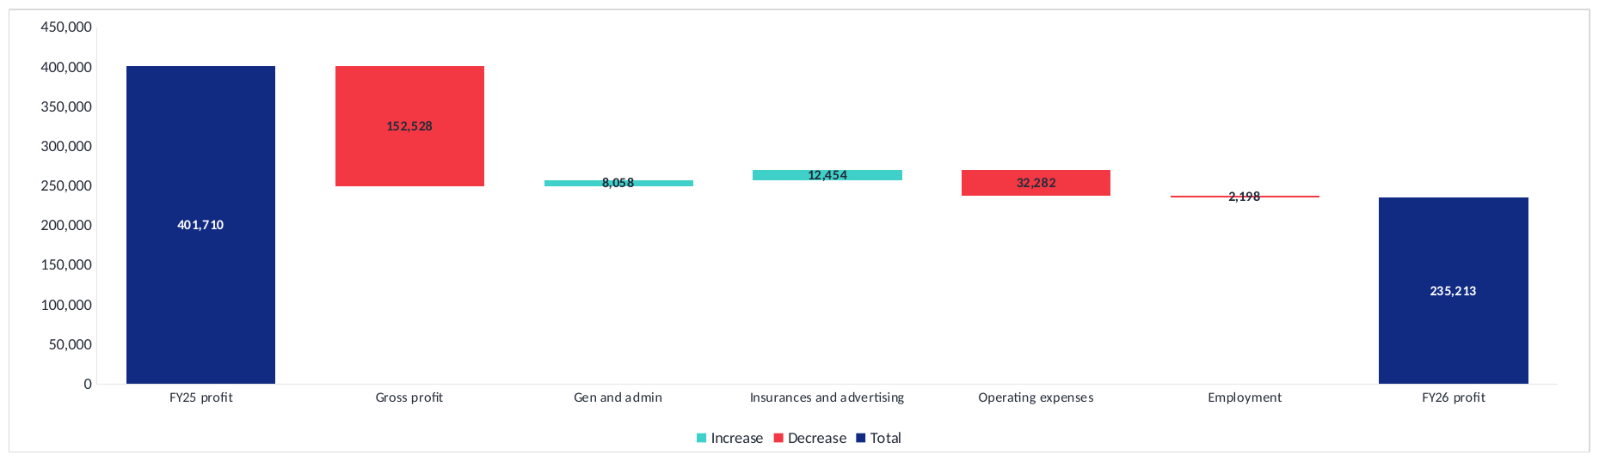


FINANCIAL PERFORMANCE|Changes In Profitability, FY2025 To FY2026
COMMENTARY
Profit fell from $402k to $235k, down $166k.
Gross profit is the whole of it, down $153k.
Operating expenses took another $32k and employment $2k.
Gen and admin gave back $8k and insurances and advertising $12k.
The two gains together recover $21k, which is an eighth of the fall.
Nothing on the overhead side of this bridge comes close to the gross profit movement.
Notes:
Changes in profitability FY2025 to FY2026, carried over from page 14 of the Q4 FY2026 Business Advisory pack, exactly as that pack has it.
FY25 profit 401,710.
Gross profit -152,528.
Gen and admin +8,058.
Insurances and advertising +12,454.
Operating expenses -32,282.
Employment -2,198.
FY26 profit 235,213.
One thing to know before this is presented. The Q4 pack does not agree with itself on the FY25 opening figure. This bridge starts at 401,710; the revenue and profit page in the same pack shows 368,638 for FY25. That is 33,072 apart. Danica has asked for both to stay as they are, so neither has been changed here.
The shape of the bridge is the point regardless of which opening figure is right. Of the 166,497 fall, gross profit accounts for 152,528, which is 92% of it. The four overhead movements net to 13,968 against the company, so the overhead side of the business was close to flat.
That matters for where effort goes. A gross profit problem of this size is a pricing and mix problem, not a cost control problem, and the overhead lines on this page confirm that there was no cost blowout to point at.

Slide 14
SECTION
02
Departmental performance
Every department's result for Q1 FY2027 and how it was made
Notes:
Departmental performance for September 2026.
The pages that follow give the company result by department, the same result rolled up the way the P&L groups the business, then a page for each of the five departments, and finally departmental revenue against budget and against the same month last year.

Slide 15
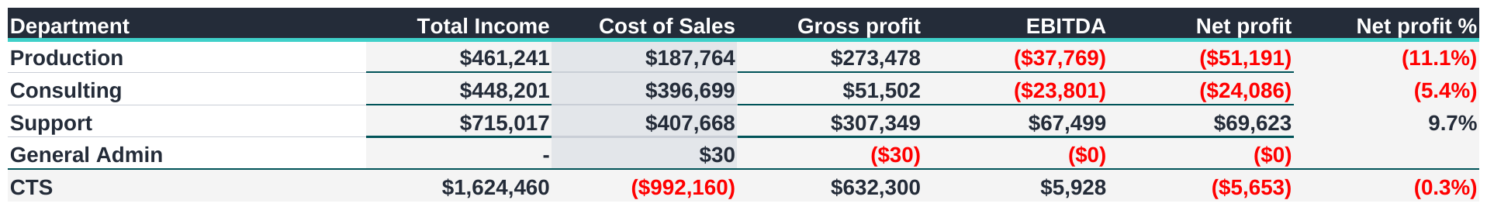
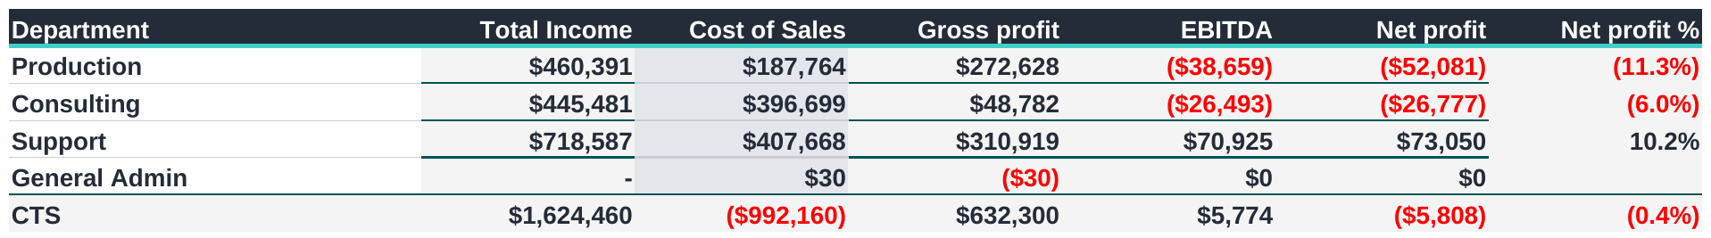
DEPARTMENTAL PERFORMANCE| Results By Reporting Group, Q1 FY2027
COMMENTARY
Revenue for the quarter was $1,624k and gross profit $632k, a margin of 38.9%.
Support is the only reporting group above the line, earning $73k on a 10.2% net margin.
Production lost $52k across the three months and Consulting lost $27k.
Group EBITDA was $6k and the quarter closed as a net loss of $6k.
Support carries the quarter. The other two groups are $79k down between them.
Notes:
This is the quarter on the same cut as the monthly reporting group slide.
Revenue for the three months was $1,624k and gross profit $632k, which is a margin of 38.9 per cent. At group level the quarter made $6k of EBITDA and closed as a net loss of $6k.
Support is the only reporting group above the line. It earned $73k on revenue of $719k, a net margin of 10.2 per cent. Production lost $52k on revenue of $460k and Consulting lost $27k on revenue of $445k. Between them those two are $79k down, which is what Support is covering.
Consulting is the one to watch on volume. It billed almost as much as Production for the quarter but kept only $49k of gross profit against Production's $273k.
Figures come from the year to date departmental table in the controller pack and tie to the Summary tab.

Slide 16
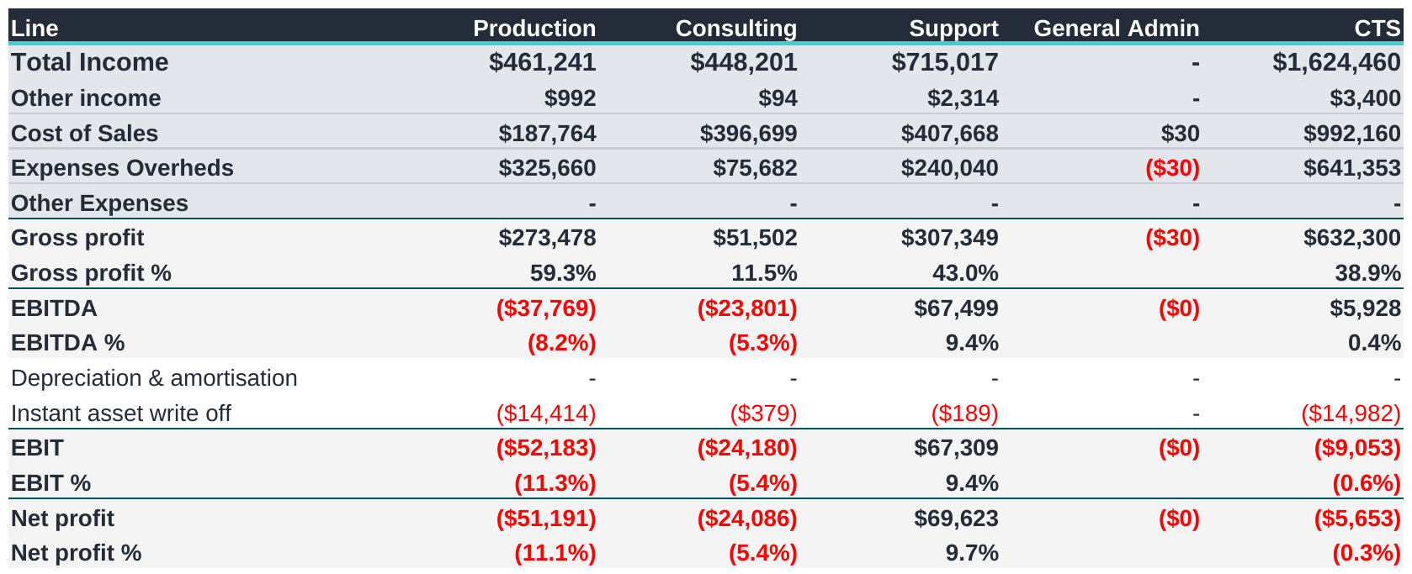
DEPARTMENTAL PERFORMANCE|Profit And Loss By Reporting Group, Q2 FY27
COMMENTARY
Support is the only group that earns its overhead back, at $70k net on a 9.7% margin.
Production holds the best gross margin at 59.3%, then loses it to $326k of overhead.
Consulting keeps only 11.5% at the gross line, the weakest of the three.
Production and Consulting are $75k down between them for the quarter.
Group EBITDA was $6k and the quarter closed as a net loss of $6k.
Notes:
A full profit and loss for the quarter, with the three reporting groups across the top.
Support earns $719k, keeps $311k at the gross line and still has $73k left after $240k of overhead. It is the only group that covers what it is charged.
Production looks strongest at the gross line, at 59.2 per cent, but carries $326k of overhead and finishes $52k down.
Consulting is the opposite problem. It bills almost as much as Production, $445k, but keeps only 11.0 per cent of it, so $49k of gross profit against $76k of overhead leaves it $27k down.
Below gross profit the pack splits to these three groups only. Events and Video sit inside Production, Integration and Consulting inside Consulting. The five department split exists down to gross profit, not below it.

Slide 17
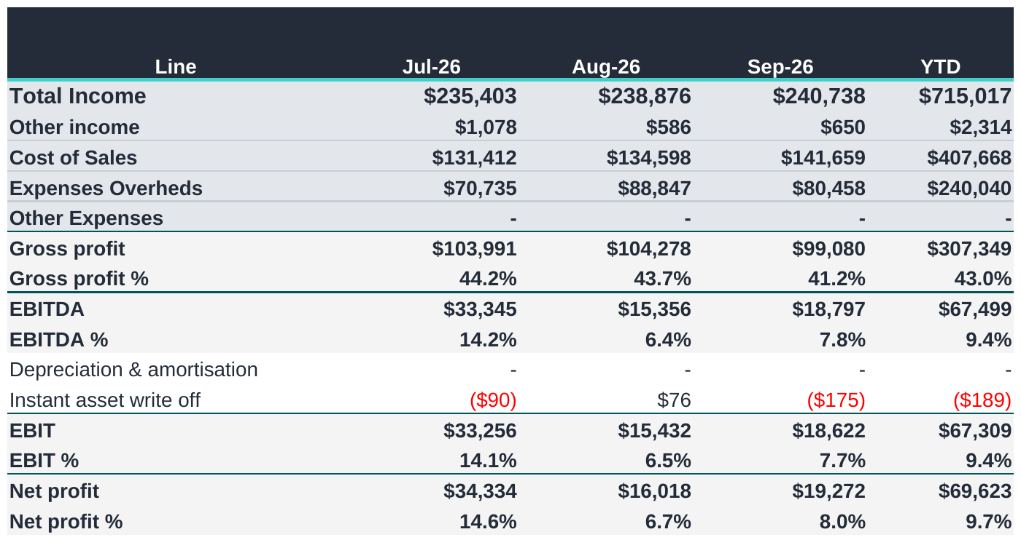
DEPARTMENTAL PERFORMANCE|Support Q1
COMMENTARY
Support billed $715k for the quarter at a 43.0% gross margin.
It is the steadiest book in the business, close to the same figure every month.
Overhead of $240k leaves $70k of net profit.
A 9.7% net margin, and the only reporting group above the line.
It is covering the losses in the other two.
Notes:
Support for September 2026, taken from the Dept P&L tab.
Revenue $243k against a budget of $248k, behind by $5k. September last year was $231k.
After direct costs of $142k it retained $101k, being 41.7% of revenue.
Overheads charged to it were $80k, of which $13k is its own spending and $67k is its share of the office, allocated on the keys set in the pack.
That leaves $21k for the month.
Year to date it has billed $719k against a budget of $743k.
On people, employment expense of $52k, of which $9k is its own staff and $43k its share of office wages. It recorded 2,132 billable hours and 11 non-billable, with 218 hours of leave.

Slide 18
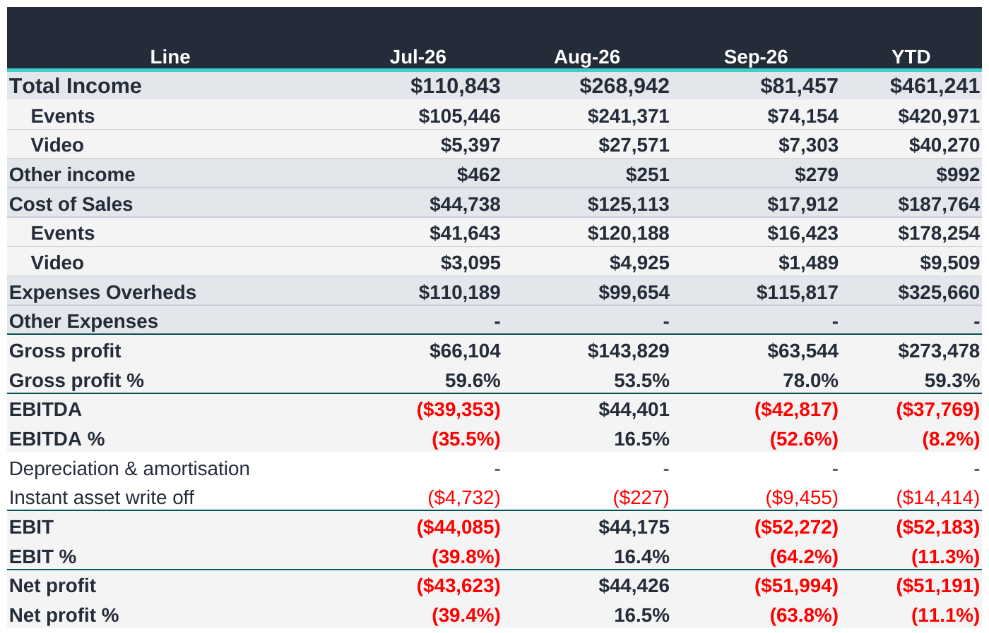
DEPARTMENTAL PERFORMANCE|Production Q1
COMMENTARY
Production billed $461k for the quarter and kept $273k at the gross line, 59.3%.
August carried it. Most of the quarter landed in that one month.
July and September were both loss making.
Overhead of $326k turns that gross profit into a net loss of $51k.
Events is almost all of it. Video is small on both sides.
Notes:
Support for September 2026, taken from the Dept P&L tab.
Revenue $243k against a budget of $248k, behind by $5k. September last year was $231k.
After direct costs of $142k it retained $101k, being 41.7% of revenue.
Overheads charged to it were $80k, of which $13k is its own spending and $67k is its share of the office, allocated on the keys set in the pack.
That leaves $21k for the month.
Year to date it has billed $719k against a budget of $743k.
On people, employment expense of $52k, of which $9k is its own staff and $43k its share of office wages. It recorded 2,132 billable hours and 11 non-billable, with 218 hours of leave.

Slide 19
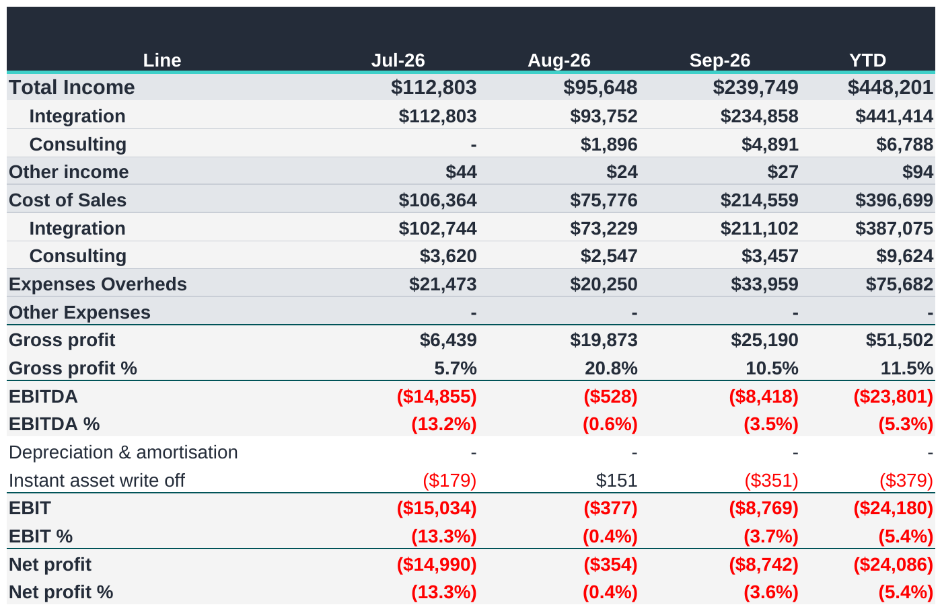
DEPARTMENTAL PERFORMANCE|Consulting Q1
COMMENTARY
Consulting billed $448k but kept only $52k, a 11.5% gross margin.
September is the month. Most of the quarter arrived on project completion.
Integration is the volume. The Consulting department itself billed very little.
Overhead of $76k leaves a net loss of $24k.
This is turnover without margin rather than a cost problem.
Notes:
Support for September 2026, taken from the Dept P&L tab.
Revenue $243k against a budget of $248k, behind by $5k. September last year was $231k.
After direct costs of $142k it retained $101k, being 41.7% of revenue.
Overheads charged to it were $80k, of which $13k is its own spending and $67k is its share of the office, allocated on the keys set in the pack.
That leaves $21k for the month.
Year to date it has billed $719k against a budget of $743k.
On people, employment expense of $52k, of which $9k is its own staff and $43k its share of office wages. It recorded 2,132 billable hours and 11 non-billable, with 218 hours of leave.

Slide 20
SECTION
03
Operating expenditure
Where the money goes and which lines move
Notes:
Running costs are steady at approximately $214k a month. Spending is not the cause of the result, but it is the figure revenue has to cover.

Slide 21
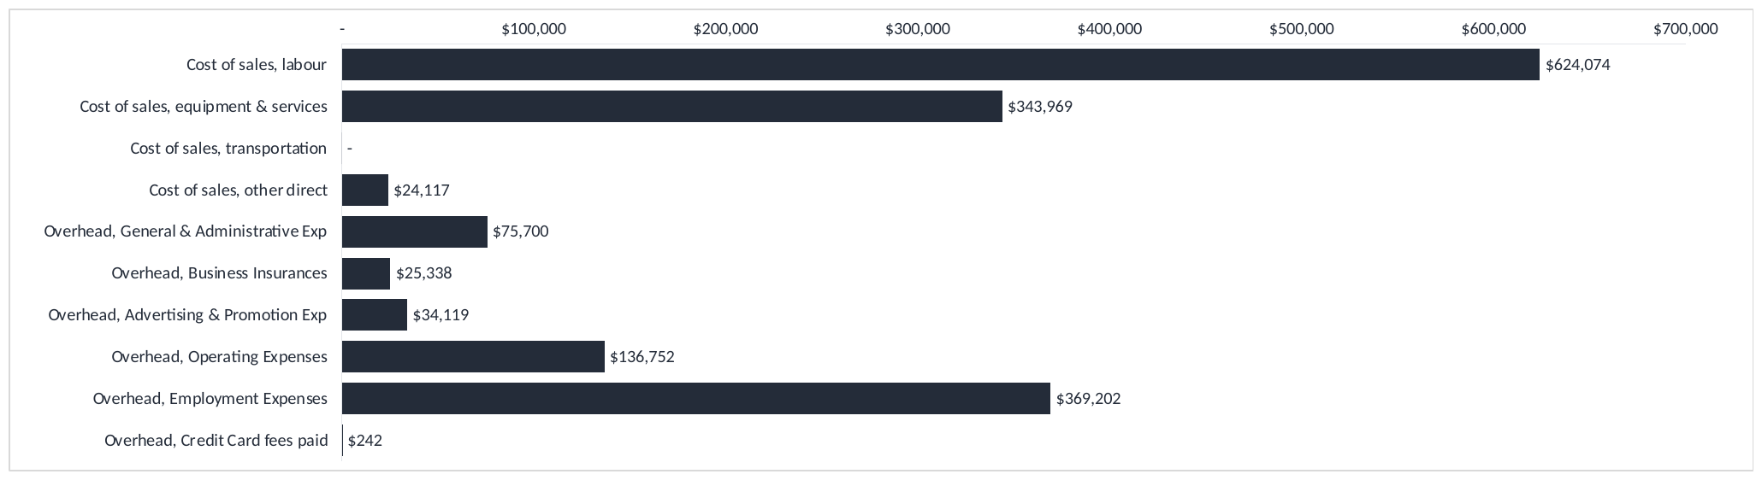
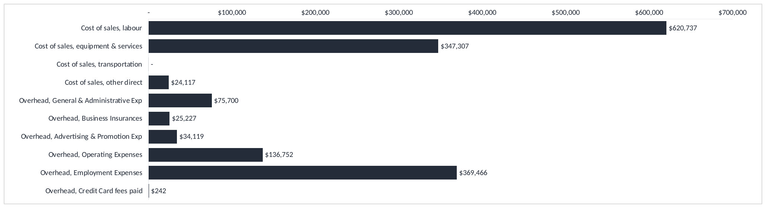

OPERATING EXPENDITURE|Operating Cost Distribution, Q1 FY27
COMMENTARY
Year-to-date direct labour costs total $621k, with a further $369k in employment overheads. Together, these represent a substantial share of total costs.
Labour is the largest cost category and has a major impact on profitability.
Much of the employment overhead is relatively fixed in the short term, even when revenue fluctuates.
Equipment and services costs of $347k are more closely linked to project activity.
Material cost reductions would require a review of staffing capacity, utilisation and premises costs, while maintaining service delivery.
Notes:
Operating cost distribution for the year to date, with cost of sales and overhead shown on one scale.
Cost of sales, labour $621k at 38.0%. Cost of sales, equipment and services $347k at 21.3%. Cost of sales, other direct $24k at 1.5%. Overhead, general and administrative $76k at 4.6%. Overhead, business insurances $25k at 1.5%. Overhead, advertising and promotion $34k at 2.1%. Overhead, operating expenses $137k at 8.4%. Overhead, employment expenses $369k at 22.6%.
The concentration is the point. Wages for staff on jobs and wages for everyone else make up the bulk of the cost base, and the second group is largely fixed within the year, which is why a quieter month passes straight to the result.
If the question is where costs can be reduced, the honest answer is headcount or premises. Reductions in subscriptions and travel would not change this picture materially.

Slide 22
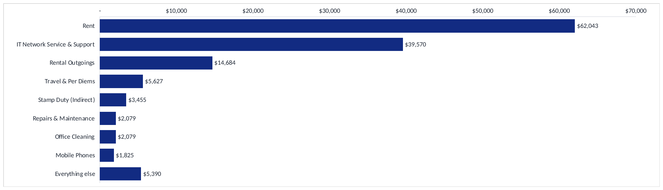


OPERATING EXPENDITURE|Other Operating Expenses, Q1 FY27
COMMENTARY
Rent and property outgoings total approximately $77k year to date, making premises the largest expense in this category.
IT network support is the next largest cost at approximately $40k.
Most remaining individual categories are below $6k for the quarter.
Smaller expense reductions may help, but are unlikely to materially change overall profitability.
Any substantial saving in this category would require a review of premises and lease commitments.
Notes:
Other operating expenses for the year to date.
Rent $62k at 45.4%. IT network service and support $40k at 28.9%. Rental outgoings $15k at 10.7%. Travel and per diems $6k at 4.1%. Stamp duty, indirect, $3k at 2.5%. Repairs and maintenance $2k at 1.5%. Office cleaning $2k at 1.5%. Mobile phones $2k at 1.3%. All other items $5k at 3.9%.
Rent and outgoings are fixed by the lease. IT support is the next largest and the only item that moves with activity.
The practical conclusion is that savings of any size do not come from this category. A material reduction would require a discussion about the office lease.

Slide 23
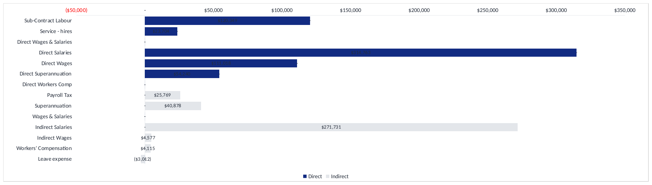


OPERATING EXPENDITURE|Direct And Indirect Labour, Q1 FY27
COMMENTARY
Direct labour consists of employee costs and external contractors or service hires.
Employee salaries, wages and superannuation account for most direct labour costs.
Contractor spending generally changes with project demand and resourcing requirements.
Reviewing contractor costs alongside staff utilisation will help identify opportunities to use existing capacity.
Improving the proportion of working hours that can be billed is important for protecting margins.
Notes:
Labour mix for the year to date, direct labour charged to cost of sales split by type.
Sub-contract labour $117k. Service hires $24k. Direct salaries $315k. Direct wages $111k. Direct superannuation $54k.
The majority is permanent payroll. Contractors are the only labour cost that rises and falls with the work.
This is the link to the utilisation section. The business pays for hours worked and invoices for hours that are chargeable, and margin follows the difference between the two.

Slide 24
SECTION
04
Customers and receivables
Who pays us, how much, and how slowly
Notes:
Revenue is concentrated and cash is slow. Days sales outstanding is 47.2 days against a 30 day target, which represents $304k of cash held in the receivables book above where it should be.

Slide 25
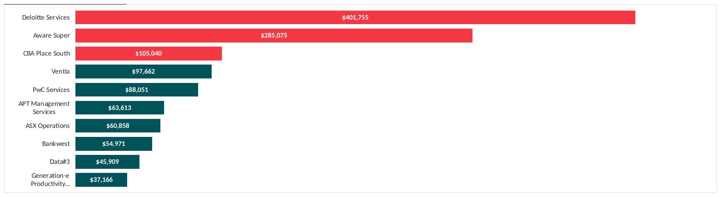


CUSTOMERS AND RECEIVABLES|Top Ten Customers By Revenue, Q1 FY27
COMMENTARY
The top three customers account for approximately 49% of year-to-date revenue.
The top ten contribute 76%, leaving 24% from all other customers combined.
Deloitte Services represents approximately 25% of revenue at $402k, creating significant customer concentration risk.
Aware Super contributed $285k during the quarter, mainly from a one-off September project.
Revenue drops considerably beyond the largest customers, highlighting the importance of growing the wider customer base.
Notes:
The ten largest customers by revenue for the year to date, with the top three highlighted.
1. Deloitte Services: $402k for the year, 24.7% of the total, $120k of it in September.
2. Aware Super: $285k for the year, 17.5% of the total, $241k of it in September.
3. CBA Place South: $105k for the year, 6.5% of the total, $30k of it in September.
4. Ventia: $98k for the year, 6.0% of the total, $9k of it in September.
5. PwC Services: $88k for the year, 5.4% of the total, $27k of it in September.
6. APT Management Services: $64k for the year, 3.9% of the total, $5k of it in September.
7. ASX Operations: $61k for the year, 3.7% of the total, $17k of it in September.
8. Bankwest: $55k for the year, 3.4% of the total, $17k of it in September.
9. Data#3: $46k for the year, 2.8% of the total, none in September.
10. Generation-e Productivity Solutions: $37k for the year, 2.3% of the total, $12k of it in September.
The ten together represent $1,240k, or 76.3% of total revenue. Every other customer accounts for the remaining $384k. The three highlighted customers are 48.7% of the year between them.
The distinction that matters is contracted work against one-off projects. Deloitte Services is contracted support that renews monthly. Aware Super is a fit-out that has now completed. Treating the two as the same kind of income is how a forecast goes wrong.
I would suggest a named relationship owner for each of the top three before the half year, and that the new business target is set on customers four to twenty rather than on the accounts the business already holds.

Slide 26
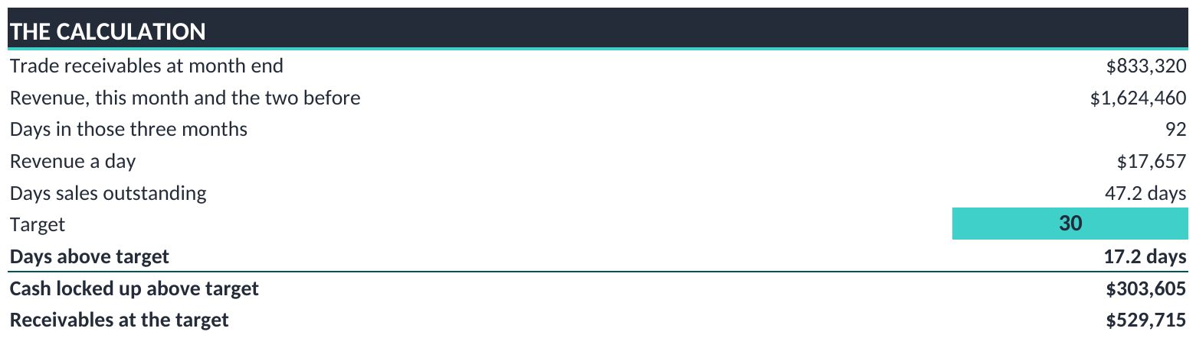
CUSTOMERS AND RECEIVABLES|Debtor Days And Collection Performance
COMMENTARY
Days sales outstanding is 47.2 days, compared with a target of 30 days.
This represents approximately 17 additional days of revenue tied up in receivables.
At the current revenue rate, closing the gap could release approximately $304k in working capital.
Each day of improvement is equivalent to approximately $17.7k in receivables at the current sales rate.
Collections should remain a short-term cash-flow priority, with focus on larger outstanding balances.
Notes:
Days sales outstanding at 30 September 2026.
Receivables are $833k. Over the last three months the business sold $1,624k, which across 92 days is $18k of sales a day. On that basis customers are taking 47.2 days to pay.
The target is 30 days, so the book is 17.2 days over. Collected on time, receivables would be $530k rather than $833k, leaving $304k of cash in the book that should already be with the business.
Set against the result, the quarter produced $6k of EBITDA while $304k remains uncollected. Collection is worth considerably more this quarter than any trading improvement available in the time, and it requires no additional cost.
Each day removed from the figure returns approximately $18k.

Slide 27
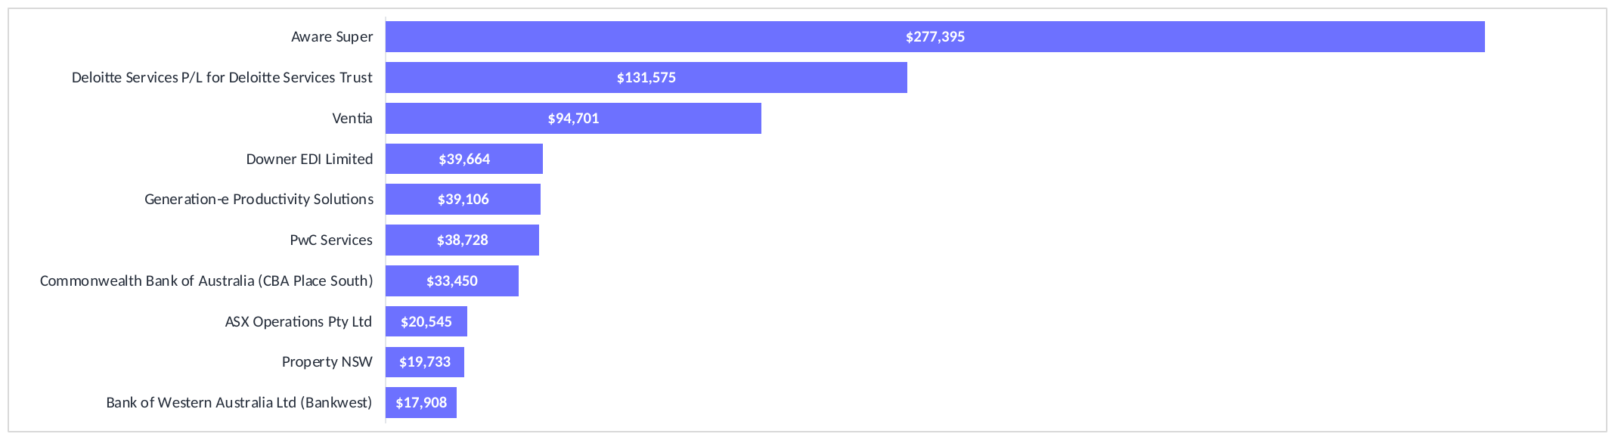


CUSTOMERS AND RECEIVABLES|Aged Receivables By Customer
COMMENTARY
Aware Super has an outstanding balance of $277k, representing 33% of total receivables.
Together with Deloitte Services P/L for Deloitte Services Trust at $132k, the two account for approximately 49% of receivables.
Overdue amounts total approximately $245k, or 29% of the debtor balance.
Collections efforts should prioritise these larger accounts while maintaining follow-up on other overdue invoices.
A targeted collections plan with clear owners and follow-up dates is likely to be more effective than a broad reminder process alone.
Notes:
The ten largest amounts owed at 30 September 2026.
Aware Super: $277k, 33.3% of the total.
Deloitte Services P/L for Deloitte Services Trust: $132k, 15.8%.
Ventia: $95k, 11.4%.
Downer EDI Limited: $40k, 4.8%.
Generation-e Productivity Solutions: $39k, 4.7%.
The ageing profile is current $589k at 70.7%, under one month $133k at 16.0%, one month $87k at 10.4%, and three months $25k at 3.0%. Overdue in total $245k, or 29.3% of the book.
Two customers hold most of the balance, so a targeted approach to those accounts would be more productive than a general collections exercise, and it represents the fastest cash available to the business this quarter.

Slide 28
SECTION
05
People and utilisation
Chargeable hours and the profit they produce
Notes:
The company invoiced 2,438 hours in September 2026 out of 3,395 it was available for, which is 72%. Where chargeable hours fall short, margin follows.

Slide 29
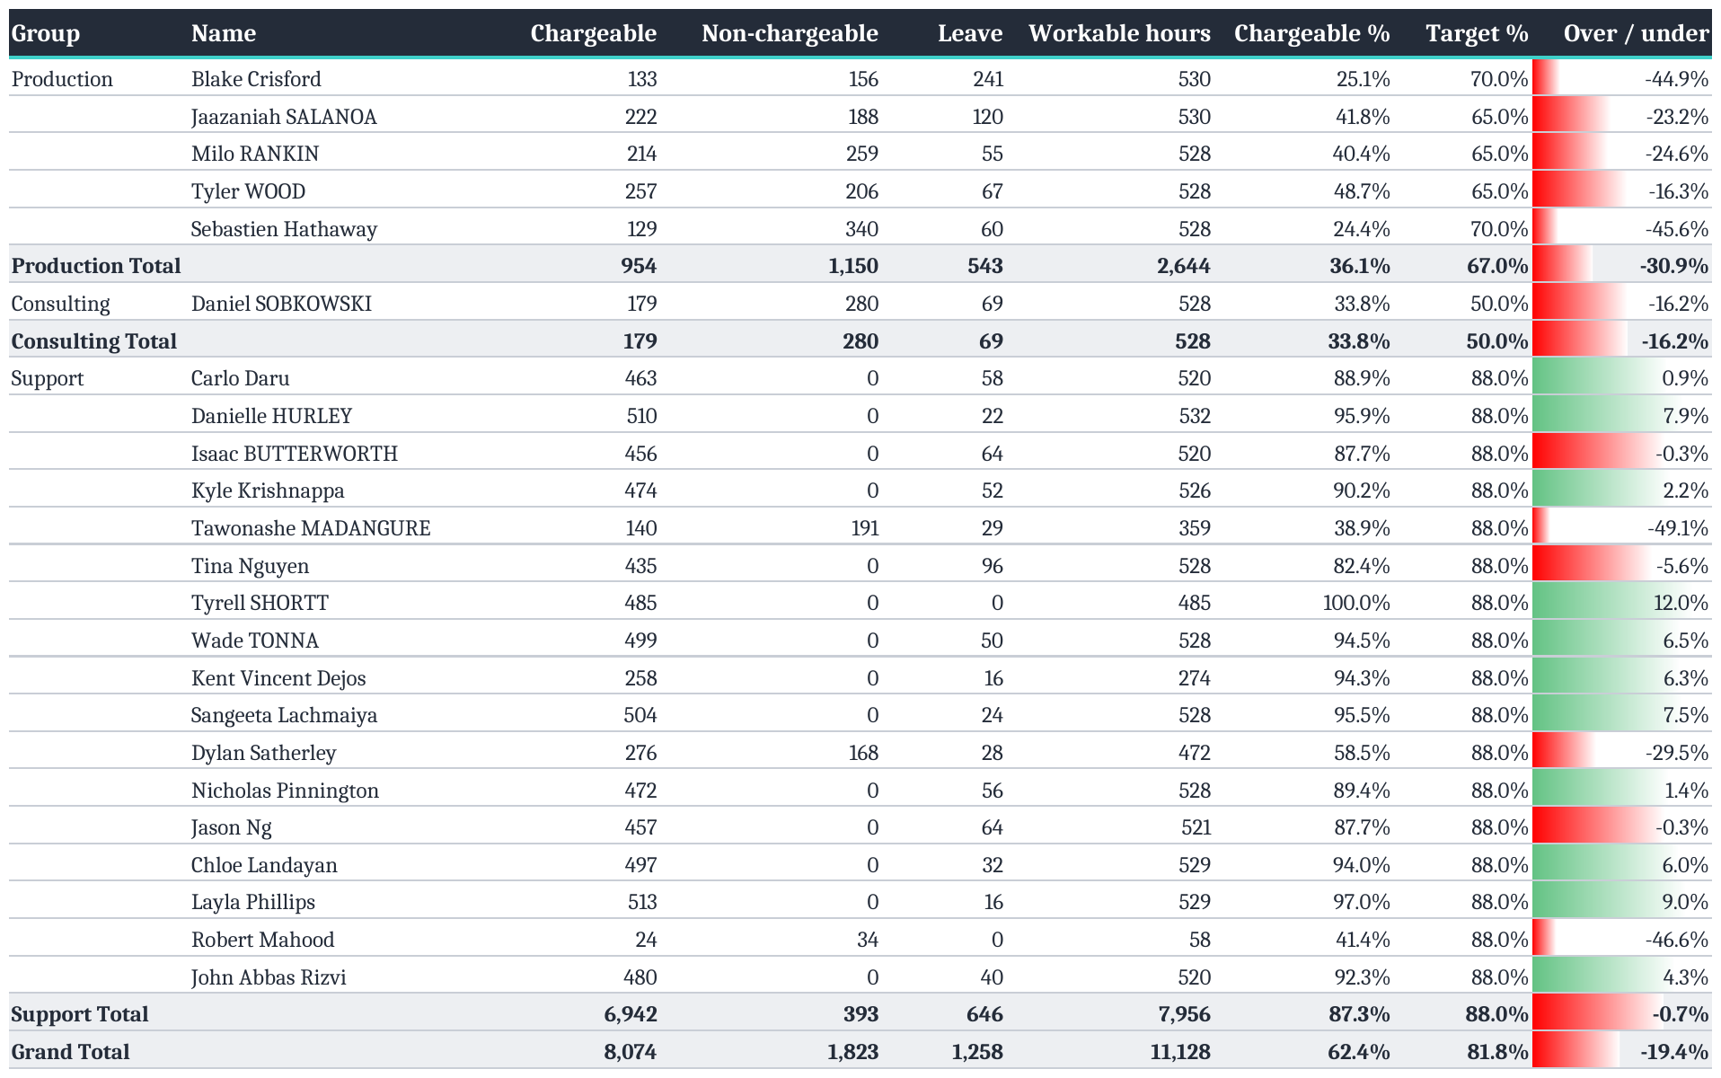
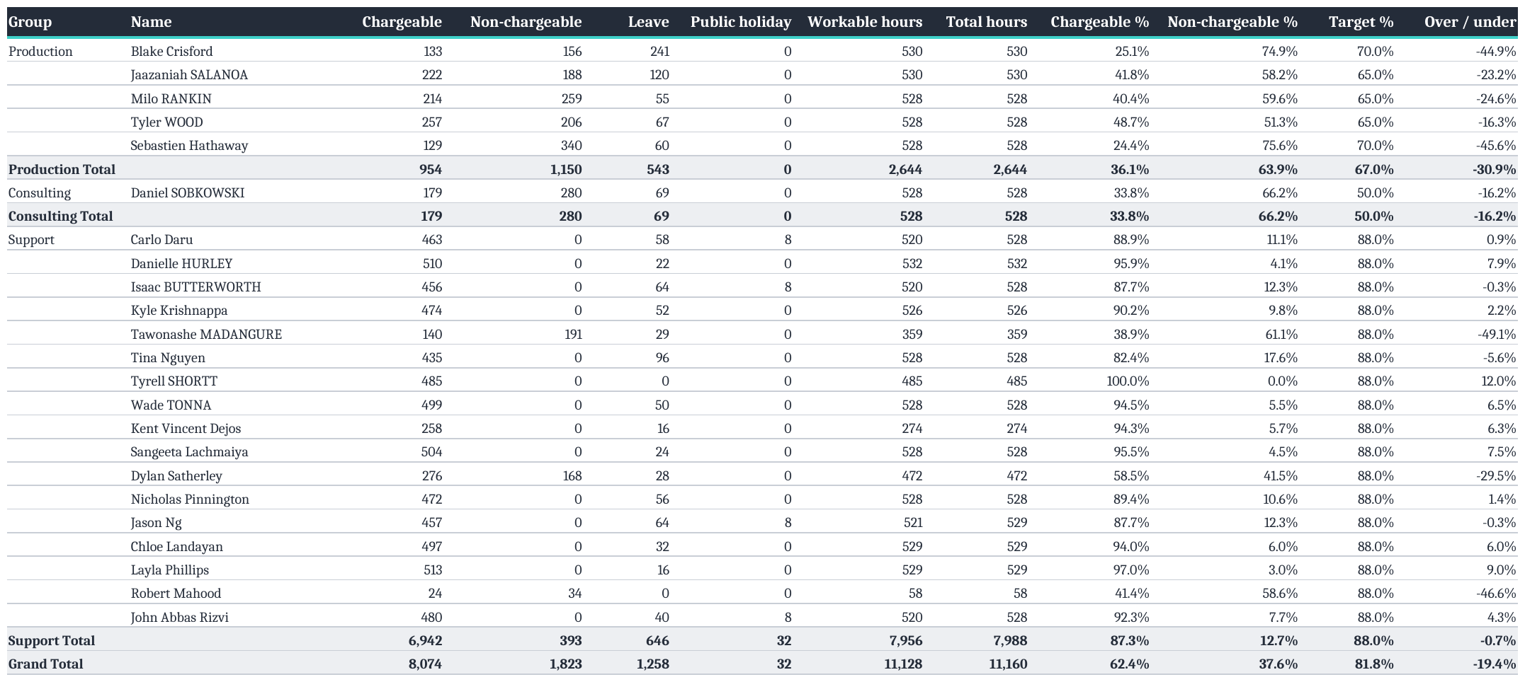
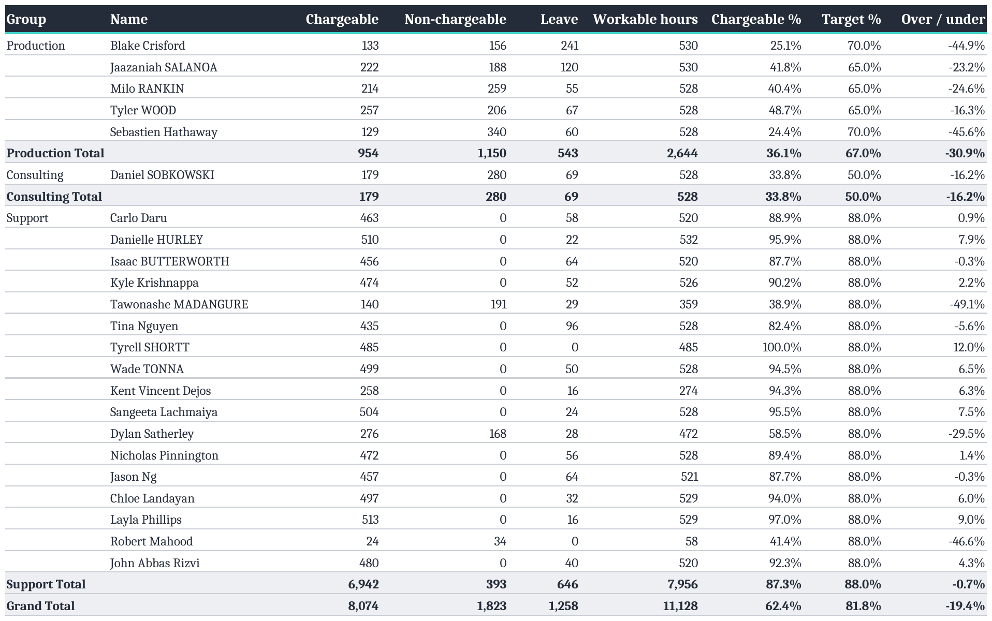
PEOPLE AND UTILISATION|Utilisation Per Employee, FY27 Q1
COMMENTARY
Support ran 6,942 chargeable hours against 393 non-chargeable, 95% of hours worked.
Production billed 954 hours against 1,150 non-chargeable, so over half its worked time was not billed.
Consulting is the same shape on a smaller base, 179 against 280.
Leave took 1,258 hours across the quarter, 543 of it in Production.
Across CTS the quarter ran 8,074 chargeable hours against 1,823 non-chargeable, 62% chargeable against an 82% target.
Notes:
Support ran 6,942 chargeable hours against 393 non-chargeable, 95% of hours worked.
Production billed 954 hours against 1,150 non-chargeable.
Consulting is the same shape on a smaller base, 179 against 280.
Leave took 1,258 hours across the quarter, 543 of it in Production.
Across CTS the quarter ran 8,074 chargeable hours against 1,823 non-chargeable.

Slide 30
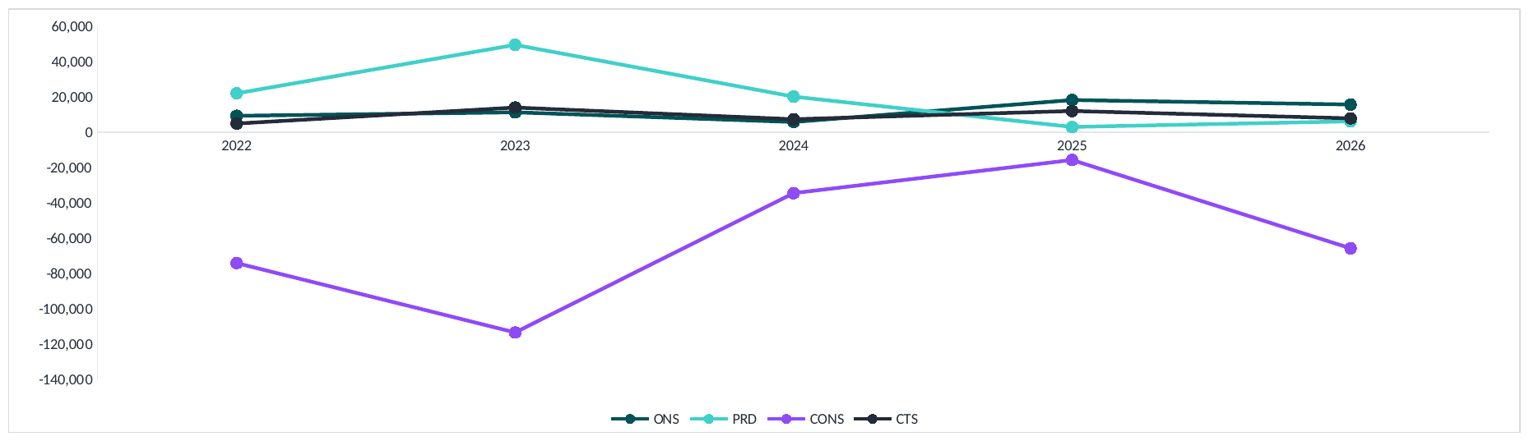


PEOPLE AND UTILISATION|Profit Per Employee
Profit Per Employee
COMMENTARY
ONS earned $16k a head, down from $18k the year before.
PRD recovered to $6k from $3k, but is still a long way under the $49k it reached in 2023.
CONS lost $66k a head, its worst year since 2023 and four times the loss it made in 2025.
CTS overall earned $8k a head, down from $12k.
CONS has not earned a positive figure in any of the five years on this chart.
Notes:
Profit per employee by reporting group, FY2022 to FY2026, carried over from page 3 of the Q4 FY2026 Business Advisory pack.
ONS 9,291 then 11,264 then 5,805 then 18,222 then 15,687.
PRD 22,035 then 49,461 then 20,148 then 2,994 then 6,196.
CONS -74,031 then -113,330 then -34,467 then -15,712 then -65,663.
CTS 4,934 then 13,985 then 7,357 then 12,013 then 7,856.
The axis has to carry CONS at -113,330 and PRD at 49,461 on the same scale, which bunches the top three lines together. That bunching is the finding rather than a fault in the chart: ONS, PRD and CTS have all sat inside a band of roughly 3,000 to 22,000 a head for four of the five years, while CONS swings by tens of thousands.
CONS has never been positive on this measure. FY2025 was the closest it came, at -15,712, and FY2026 gave back four fifths of that recovery.
FY2027 is not on the chart. Three months of a year cannot sit on a chart of full years without reading as a collapse that has not happened. Year to date the three groups stand at ONS 70,736, PRD -53,072 and CONS -26,871 in total profit, not per head.

Slide 31
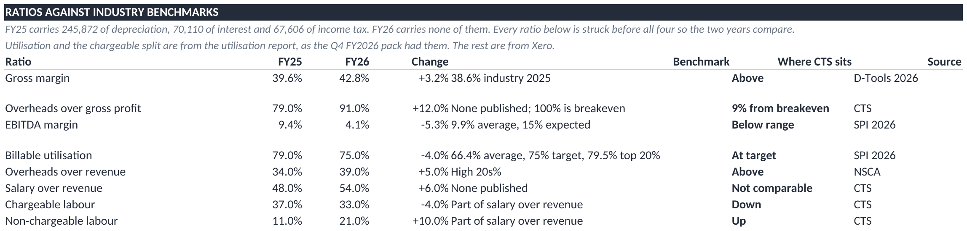
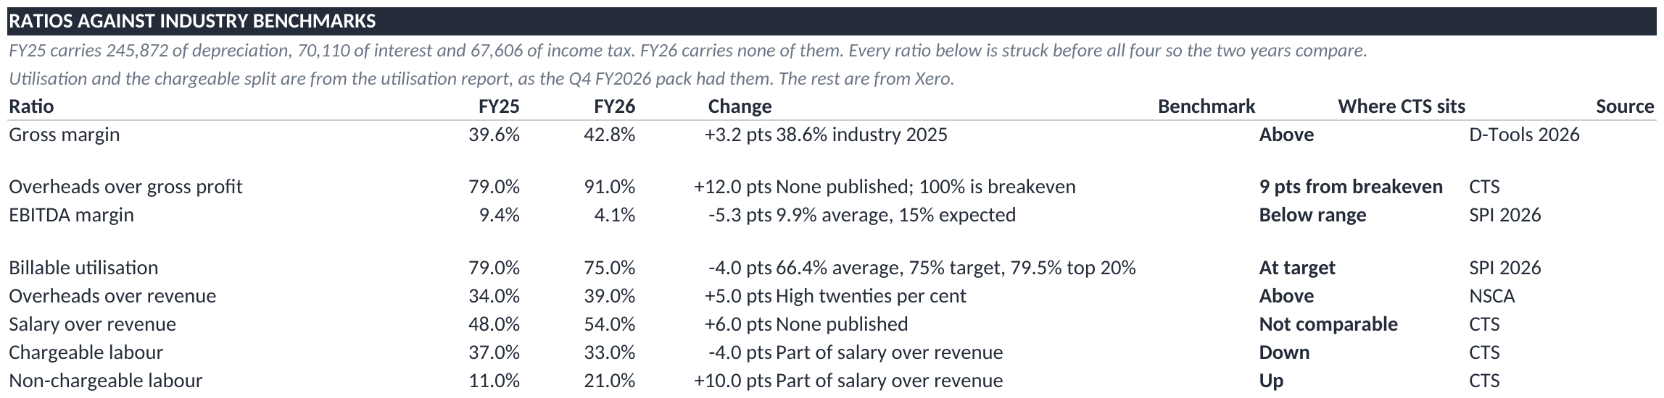
PEOPLE AND UTILISATION| Ratios Against Industry Benchmarks
COMMENTARY
Gross margin is 42.8%, above the 38.6% the integrator benchmark reports for 2025.
EBITDA margin is 4.1% against a 9.9% professional services average, and against the 15% that benchmark treats as the expected level.
Overheads take 91% of gross profit. At 100% the company breaks even, so there is 9.0% of cover left.
Utilisation is 75%, which is the benchmark target and 8.6% above the 66.4% average.
Salary is 54% of revenue, up 6%, and non-chargeable labour has nearly doubled from 11% to 21%.
No published benchmark was found for overheads over gross profit or for salary to revenue on comparable definitions.
Notes:
Gross margin is 42.8%, above the 38.6% the integrator benchmark reports for 2025.
EBITDA margin is 4.1% against a 9.9% professional services average, and against the 15% that benchmark treats as the expected level.
Overheads take 91% of gross profit. At 100% the company breaks even, so there is 9.0% of cover left.
Utilisation is 75%, which is the benchmark target and 8.6% above the 66.4% average.
Salary is 54% of revenue, up 6%, and non-chargeable labour has nearly doubled from 11% to 21%.
No published benchmark was found for overheads over gross profit or for salary to revenue on comparable definitions.

Slide 32
SECTION
06
Budget and outlook
What the rest of the year looks like and what we change
Notes:
Three months are closed and the remaining nine remain at original budget. That is the matter before the board.

Slide 33
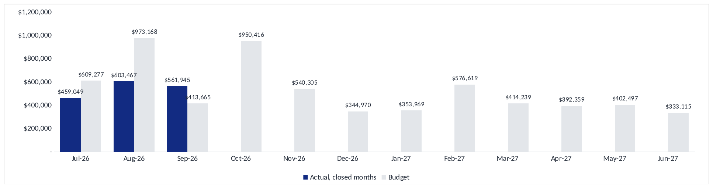
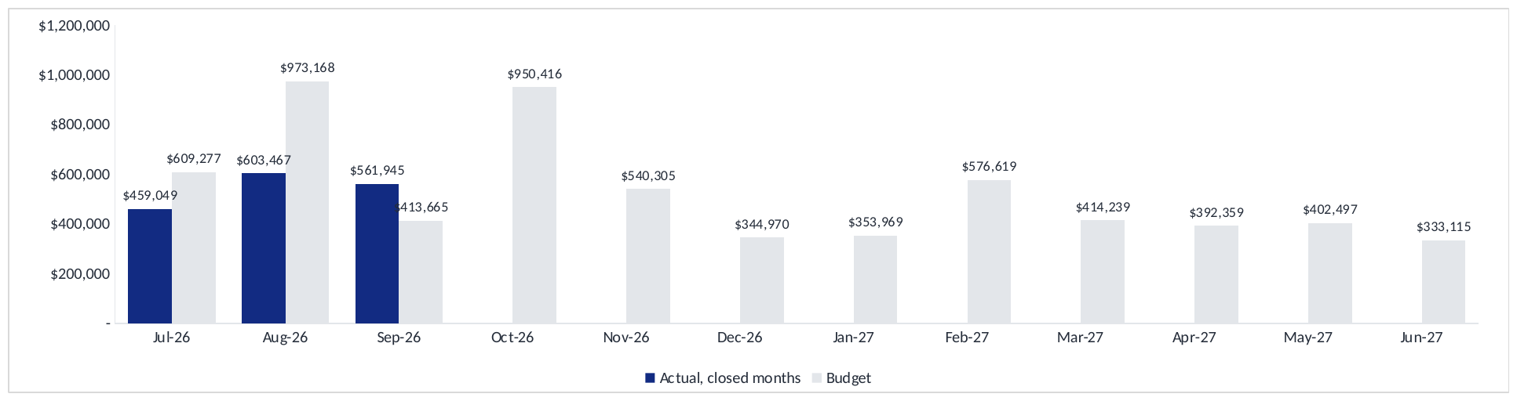

BUDGET AND OUTLOOK| Full Year Revenue Against Budget
COMMENTARY
First-quarter revenue was $372k below budget, with significant shortfalls in Consulting and Video.
October to June currently reflects the original budget rather than an updated forecast.
October revenue is budgeted at $950k, well above the highest actual month recorded so far this year.
December includes a planned loss reflecting the two-week business closure, which should remain in the revised assumptions.
Recommend preparing an updated rolling forecast using actual delivery capacity and achievable gross margins.
Notes:
Revenue by month, actual for the three closed months and original budget thereafter.
First quarter actual of $1,624k against a budget of $1,996k, behind by $372k.
The nine months from October remain at the budget set before the year began. October is budgeted at $950k, which is higher than any month the business has delivered.
Two points for the board. The first quarter variance is concentrated in Consulting and Video, which were budgeted on a resourcing level that does not exist. And the margin assumption in the budget sits above the rate the business has delivered for two years, so a month that meets the revenue figure would still fall short on profit.
My recommendation is a rolling forecast from the second quarter, rebuilding Consulting around actual capacity and resetting gross margin to delivered rates. December would be better left as budgeted, as the business closes for two weeks and the loss is genuine.

Slide 34
RECOMMENDATIONS
Recommendations And Agreed Actions
Area | Recommendation | Owner | Target date
P&L | That FY27 is reforecast on gross margin rather than revenue. At a 38.9% gross margin, break even requires $549k a month against the $541k currently being delivered. | GC and FOM | 31 Oct 26
Overhead keys | Events carries $111k of overhead on $73k of revenue and cannot return a profit on that basis. I would suggest the keys are tested for FY28 and left unchanged within the current year. | GC and FOM | 30 Nov 26
Consulting | $20k of running costs against $4k of fees. A decision on whether the department is rebuilt, combined with Integration or closed would be timely this quarter. | GC | 30 Nov 26
Customers | The top three customers represent 48.7% of revenue. A named retention plan for each, with the growth target set on customers four to twenty, would reduce that concentration. | GC and Sales | 14 Nov 26
Cash | Days sales outstanding is 47.2 days. Reaching 30 days would release $304k. Aware Super and Deloitte Services P/L for Deloitte Services Trust hold most of the balance. | FOM | 24 Oct 26
Utilisation | Chargeable per cent is 72% against the report's own 81% target. Five additional points across Support and Production would be worth approximately $16k a month at no additional cost. | Ops and FOM | 30 Nov 26
Leave | Production recorded 333 hours of leave on 882 available. Planning leave against the booking calendar would protect delivery capacity. | Ops | 30 Nov 26
Notes:
Seven recommendations, each with a suggested owner and date.
The first two carry the most weight: reforecasting on margin rather than revenue, and reviewing the overhead keys. Most of the pack follows from those two figures.
The Consulting position has now run for three months with running costs against almost no fee income, and would benefit from a decision this quarter.
The receivables item is the only one that produces cash within the quarter, and utilisation remains the largest controllable item.

Slide 35
SECTION
07
Source documents
Everything in this pack comes from the files below
CTS Financial Controller Pack - 30092026.xlsx
Notes:
The source files behind this pack. Every figure in the review is drawn from the Financial Controller Pack, which reconciles to the Xero general ledger.

Slide 36
cts
Seamless AV
Thank you
Questions and discussion
Notes:
Two figures to close on. At the margin the business delivers, break even requires $549k of revenue a month, and the business is running at $541k. Everything else in the pack sits underneath those two numbers.

